Slide 1
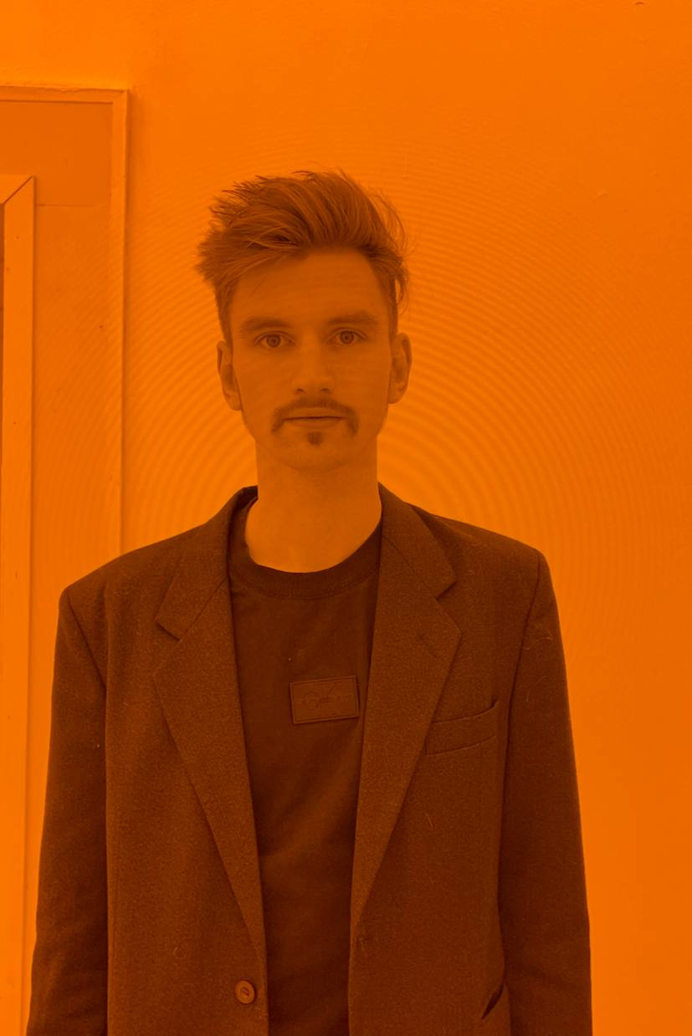
Hi! My name
is Savva Mikhailowsky
My set of skills together with the versatile experience made me productive marketing analyst and creative PM. Let my cases speak for me!

Slide 2
Here come my skills
Hard:
Canva, Photoshop, iMovie, Figma, Tilda
Notion, Slack, OBS, Ableton
Google Workspace, MS Office
SPSS, Python (jun.)
Trello, Miro
amoCRM, GetCourse, Timepad, Google Ads + Analytics
Fluent English, German B2
Soft:
Rich experience in analytical researches
Excellent skill of team management (up to 12 employees)
Broad knowledge in narrow niche (Crypto, DeFi, NFT)
Captivating charisma – I can make your client choose you
Gentle management
Work in Blockchain since 2018

Slide 3
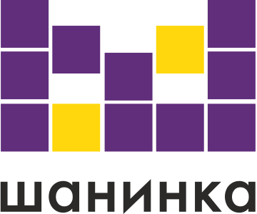
Education
+
Modern Sociological Theory, UK (2018-2022)
Marketing-Management, Moscow (2022-2024)

Slide 4
Selected cases in crypto and in NFT

Slide 5
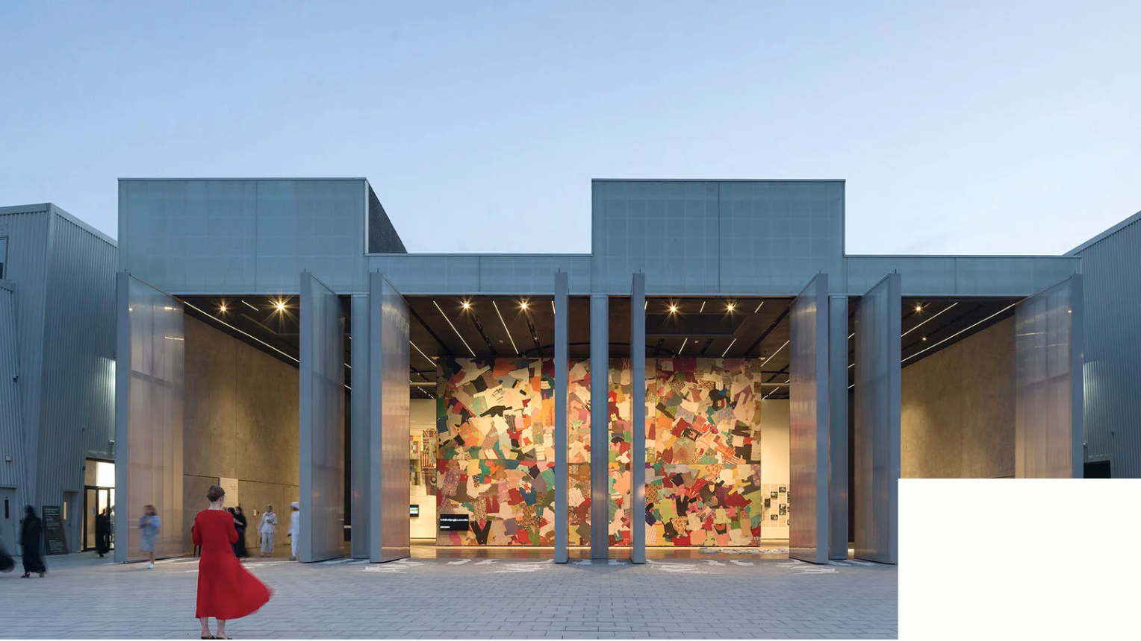
10101 The Gallery
Specificity of the project
Game-changing international f-NFT gallery
Such names as Banksy, Kandinsky, Picasso
Located in Dubai
Exclusive model of legal ownership
10101.art

Slide 6
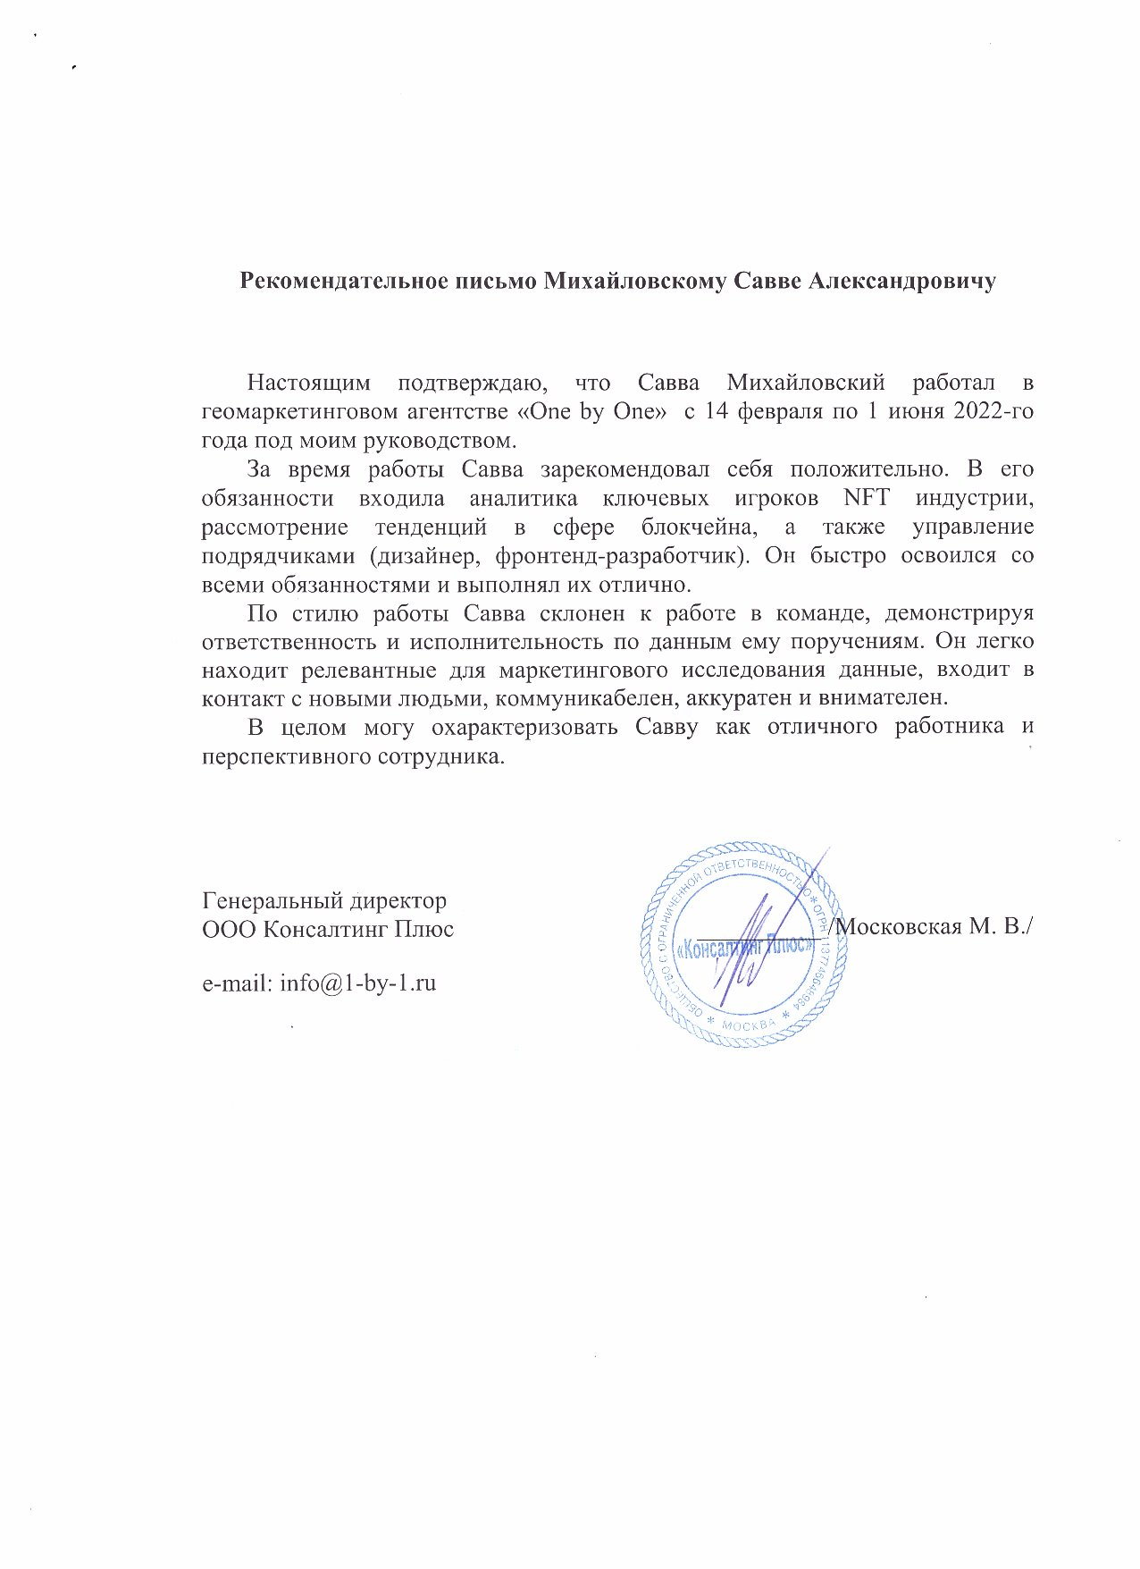
10101 The Gallery
What have I done?
Marketing pre-analysis
Selection of art (determination of demand based on G.trends and cross-check of advisors)
Number of qualitative researches
Supervision of webpage development (managed designer and front-end)
Launch of the Gallery in the role of analyst!
Proof

Slide 7
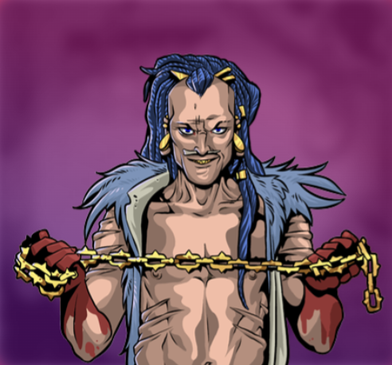
Raiders (GameFi)
What have I done?
SWOT + competitive analysis
Research of GameFi market
Quantitative surveys and interviews in community
Supervision of webpage development (advice on branding-style selection)
Development of creative and successful marketing funnel
https://raiders.game/

Slide 8
EVERscale token
Specificity of the project
Scalable token
Suitable for highly loaded projects (gameFi, NFT)
Faster than most of usual systems
everscale.network/

Slide 9
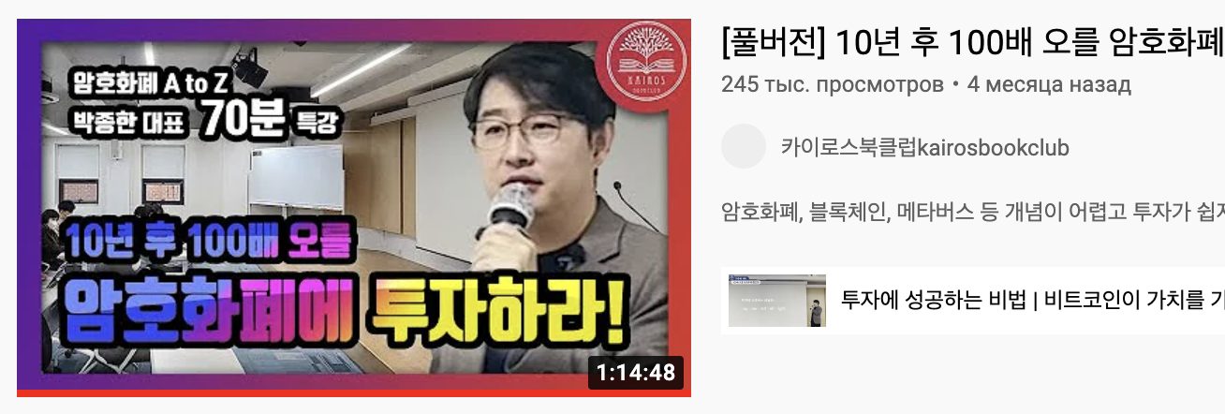
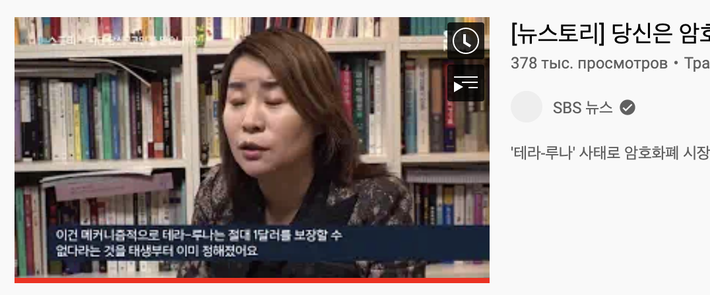
EVERscale token
What have I done
Promotion on local market (South Korea)
The research of Korean crypto-influencers
Communication with bloggers
Evaluation of conversion
Selected results

Slide 10
TMRW Gallery x VK (baking now)
Specificity of the project
Giant corporation implements NFT products
Brand new approach to client segmentation (literally 2 different types of audience)
First social media preparing to spread NFT (while meta only announced their story)
vk.com

Slide 11
TMRW Gallery x VK (baking now)
What have I done
Analysis of the marketplaces
Management of collaboration
Development of the market strategy and mechanic of sales
Research of promotion channels (in 3 different networks) with total coverage about 30 million users
Helped my team to win a fat tender (70% of data was found and researched by myself)

Slide 12
Selected cases in marketing and SMM

Slide 13
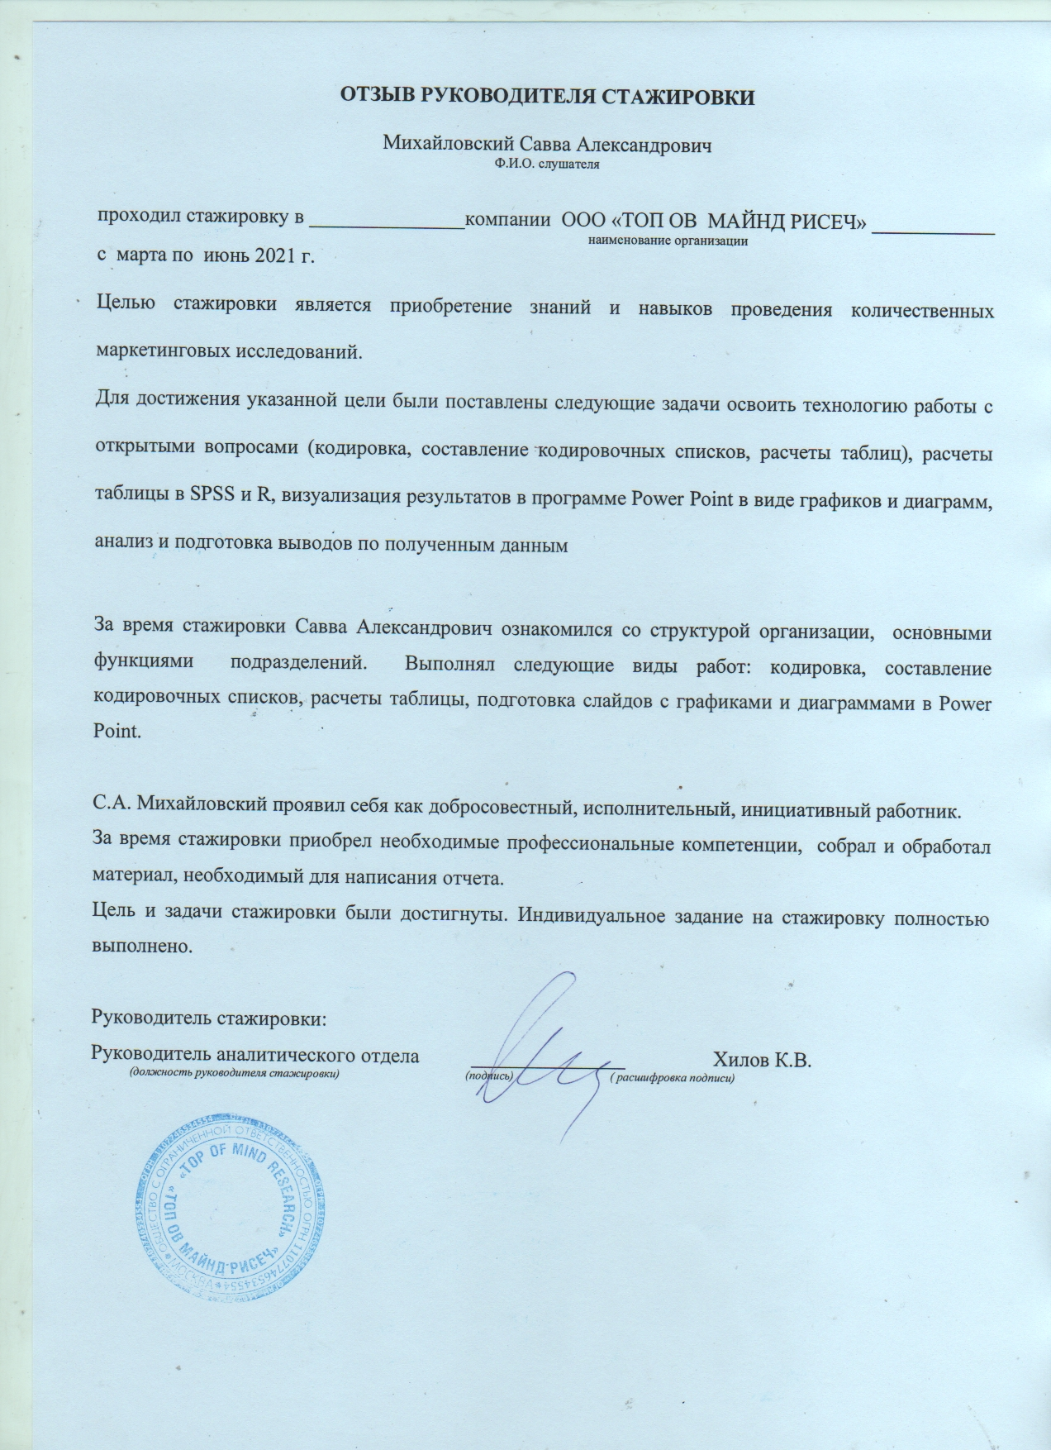
Top Of Mind marketing analysis
What have I done
Quantitative research of pharmacological market
Determination of approach to promotion of meds (in profile networks)
Communication with medical influencers
Implementation of approaches to base-sorting automation
Proof
https://www.topofmind.ru/

Slide 14
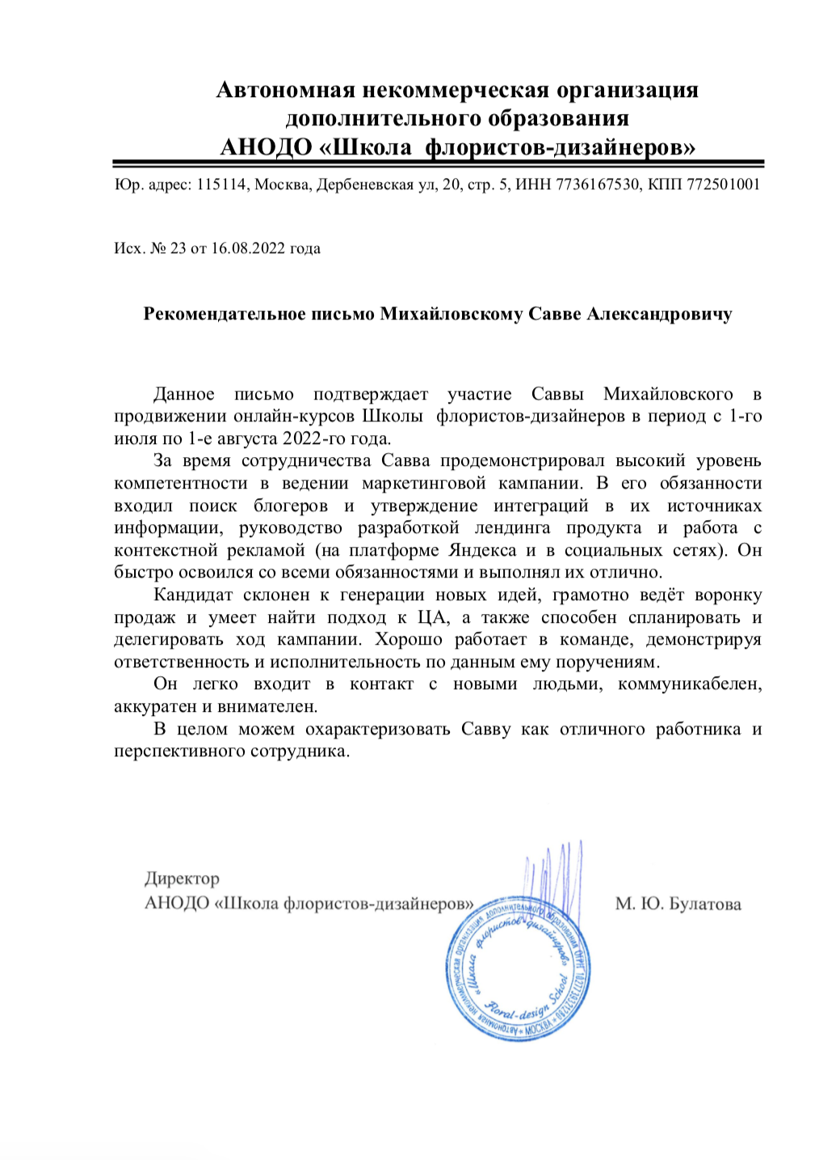
Nicole school
What have I done
Analysis of school’s market position and competitors’ identification
Total rebranding (website, logo, slogan, positioning)
Increased sales of online direction up to 40 clients (there were only 2)
Developed effective conversion funnel
Proof
https://art-nicole.com/online-school

Slide 15
Instead of conclusion
The world today is facing the crisis point. However, new conditions of the market also open up prospects for innovative projects refreshing the industry!
My experience of analytics, production and branding will help your business whatever you’re going to do: to launch a new product or to upgrade the old one.
Interested in other cases or wish to know my background? Just contact me and ask any questions you wish. Remember: history of the Blockchain is written today – take a chance to be imprinted on the pages.
Telegram: @ReptiloidCrisis
Gmail: mekalovske@gmail.com
w/a: 89299922489

