Slide 1
Progesteron

Slide 2
Introduction:
Progesterone is an endogenous steroid hormone that is commonly produced by the adrenal cortex as well as the gonads, which consist of the ovaries and the testes. Progesterone is also secreted by the ovarian corpus luteum during the first ten weeks of pregnancy, followed by the placenta in the later phase of pregnancy.
The chemical nature of progesterone is steroids. The molecule progesterone is a derivative of cholesterol and has numerous functions in the human body, especially within the reproductive system.

Slide 3
Menstrual cycle and role of progesteron
Follicular phase
The menstrual cycle begins as FSH stimulates development of an ovarian follicle. As this follicle matures, it begins producing a small but steadily rising amount of estradiol. This low level of estradiol causes:
Negative feedback: inhibition of FSH and LH secretion
Growth of the lining of the uterus.

Slide 4
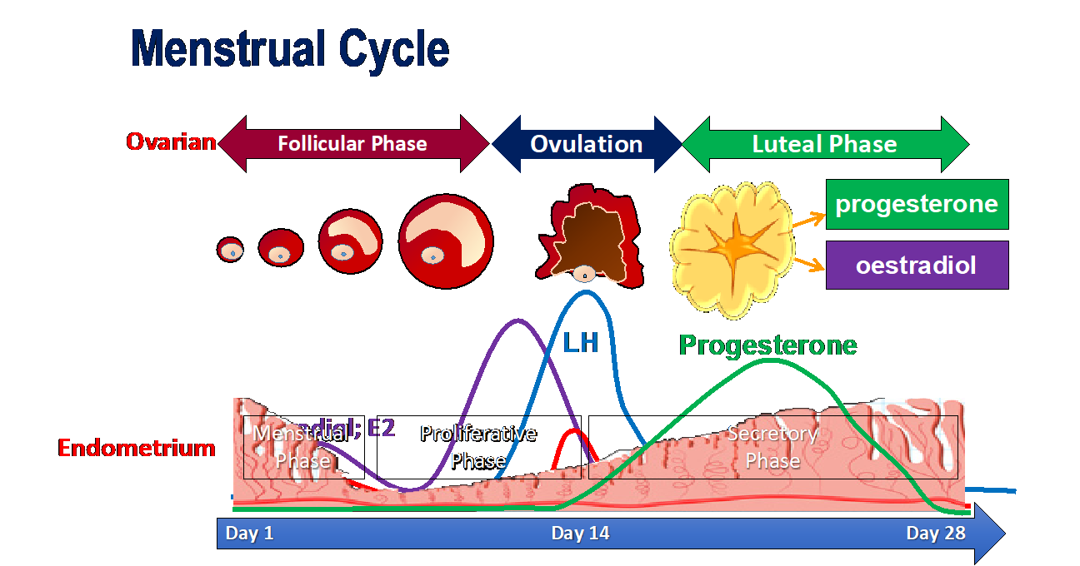
Ovulation
The amount of estradiol secreted at mid-cycle has increased to the high level that stimulates a surge of FSH and LH release by the pituitary
The LH surge causes ovulation: the follicle ruptures and releases its egg near the opening of its fallopian tube
Luteal Phase
Following the release of its egg, the follicle changes into a hormone-secreting structure, the corpus luteum, and secretes estradiol and progesterone in response to LH.
Estradiol and progesterone stimulate the continued development of the lining of uterus
If pregnancy does not occur, the corpus luteum eventually disintegrates and stops secreting estradiol and progesterone. The uterine lining sheds and menstruation occurs.

Slide 5
Progesteron in pregnancy
Before Pregnancy: Progesterone helps the uterus be prepared for pregnancy
The hormone progesterone is secreted during early pregnancy and prepares the uterus for pregnancy. It causes the luteal phase to start and transforms the endometrium (uterine lining) by thickening it to receive an embryo.
During pregnancy: Progesterone helps support the fetus as it grows
When a woman is pregnant they produce hCG (human chorionic gonadotropin hormone). This is a signal to the ovaries to continue to produce progesterone. hCG prevents the onset of her menses (the blood and matter discharged during ovulation) and enables a woman to become pregnant. Progesterone then continues to be produced, nurturing the fetus as it starts to grow. After 8-10 weeks of pregnancy, the placenta takes over progesterone production and increases production until the baby is born

Slide 6
Effect of progesterone on the fallopian tubes:
Progesterone also promotes increased secretion by the mucosal lining of the fallopian tubes. These secretions are necessary for nutrition of fertilized , dividing ovum as it traverses the fallopian tube before implantation.

Slide 7
Progesterone promotes development of the breast
Progesterone promotes development of the lobules and alveoli of the breasts, causing the alveolar cells to proliferate , enlarge , and become secretory in nature .

Slide 8
Potential Problems with Progesterone Production
Women who have low levels of progesterone will have abnormal menstrual cycles or may struggle to conceive because the progesterone does not trigger the proper environment for a conceived egg to grow. Women who have low progesterone levels and who do succeed in getting pregnant are at higher risk for miscarriage or pre-term delivery, because the hormone helps maintain the pregnancy. Signs of low progesterone include:
Abnormal uterine bleeding
Irregular or missed periods
Spotting and abdominal pain during pregnancy
Frequent miscarriages

Slide 9
Progesterone in males
Progesterone is known as a female hormone, but males need progesterone to produce testosterone. The adrenal glands and testes in males produce progesterone

